Slide 1

DBMS Mini Project “DEMO”
Name: Aditya M
USN: 2BL21CI005

Slide 2
Online Voting System: Enhancing Electoral Integrity

Slide 3

Content
Introduction
Related Work
Problem Definition
Method
Hardware and Software Requirements
Output Screenshots
Database Table Screenshots
ER Diagram and Use Case Diagram
Advantages
Limitations

Slide 4
Introduction
Online Voting System project
Importance of ensuring electoral integrity in the digital age
Introduction to the concept of online voting and its potential benefits

Slide 5

Related Work
Existing research and systems in the field of online voting
Challenges faced and solutions proposed in previous studies
Comparison with traditional voting systems

Slide 6
Problem Definition
Common issues in traditional voting systems such as poll booth capturing, ballot stuffing, etc
Explanation of how these problems undermine electoral integrity
Introduction to how an online voting system can address these issues

Slide 7
Method
implementation approach used in the project
Overview of the technology stack employed
Description of key features and functionalities of the online voting system

Slide 8
Hardware and Software Requirements
Hardware components required for deploying the system
Software tools and technologies utilized in development

Slide 9
Output Screenshots
Visual demonstration of the user interface of the online voting system
Screenshots showcasing various stages of the voting process

Slide 10
Database Table Screenshots
Display of database schema and tables used in storing voting data
Explanation of the database design and its role in ensuring data integrity

Slide 11
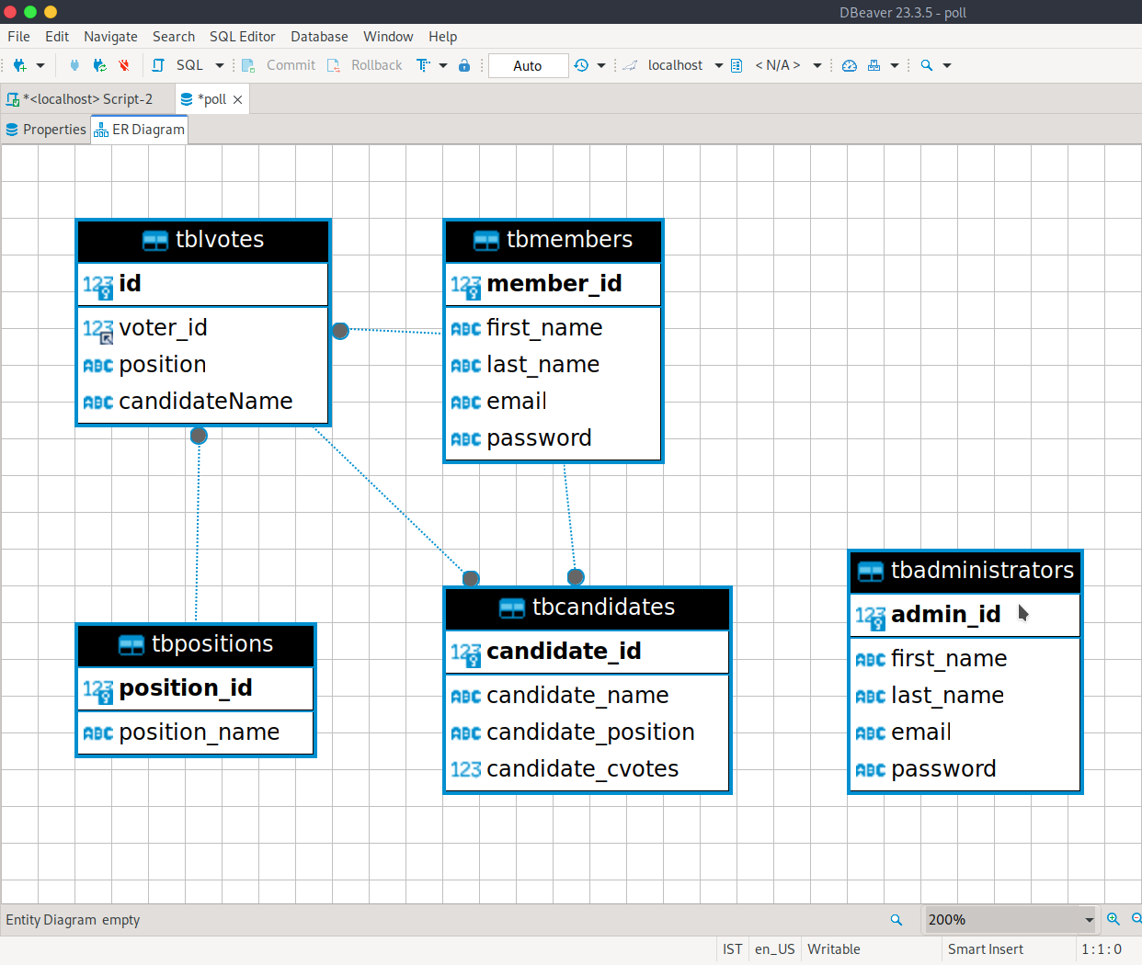
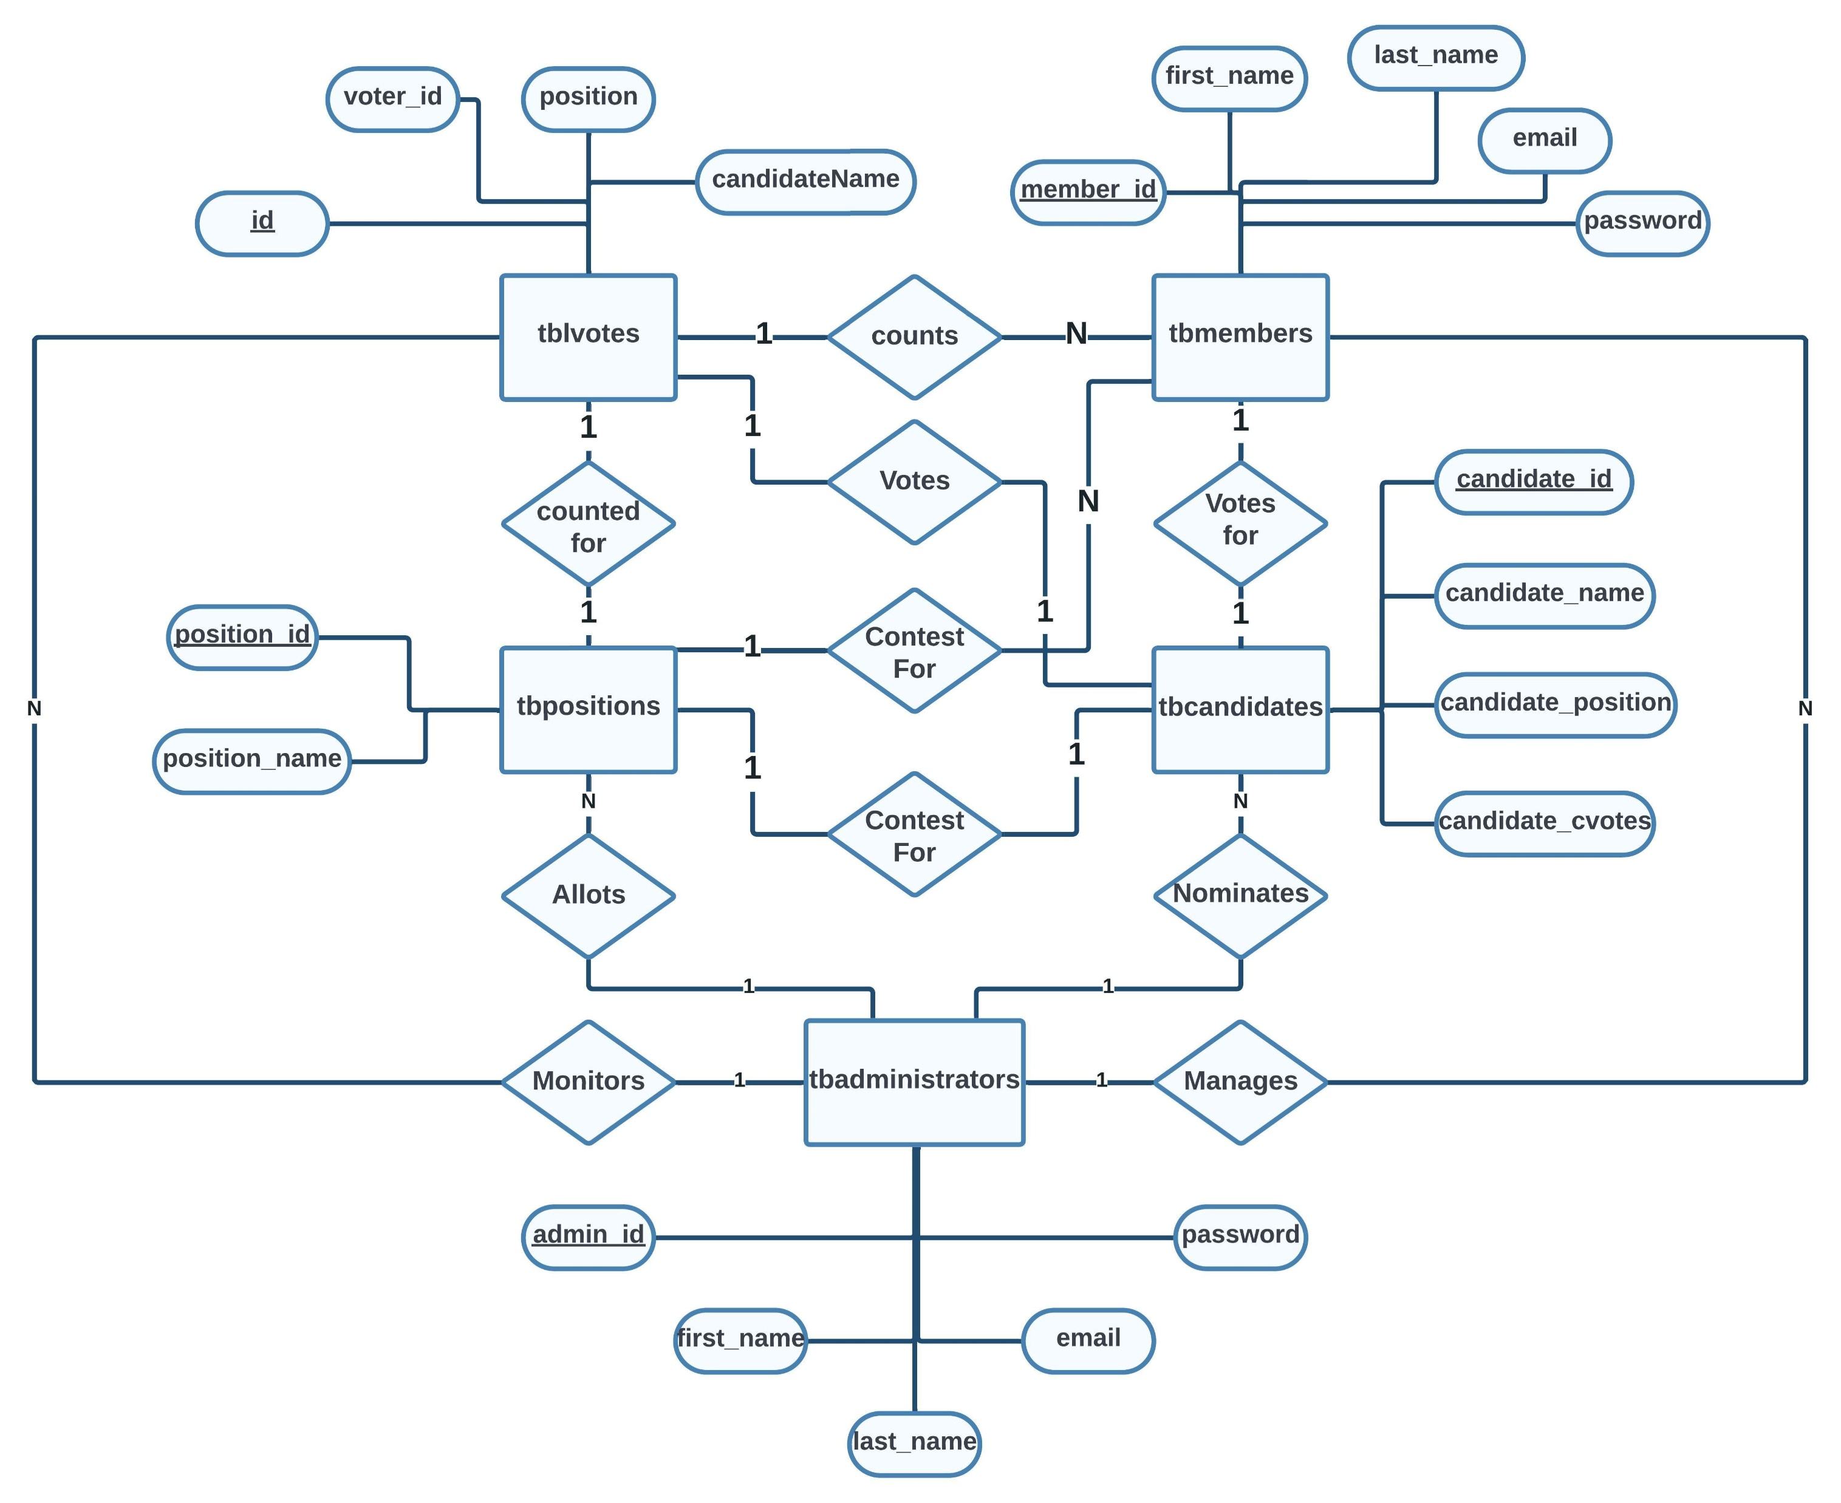
ER Diagram and Schema Diagram

Slide 12

Advantages
Benefits of an online voting system over traditional methods
Increased accessibility, efficiency, and transparency

Slide 13

Limitations
Concerns related to security, privacy, and technological barriers

Slide 14
Conclusion
outcomes of the project
Reinforcement of the importance of electoral integrity and the role of technology in achieving it
Call to action for further research and development in the field of online voting systems

